Slide 1
Exercise D
2021315385
이건 / Gun Daniel Lee

Slide 2
Problem explanation
Given two numbers n and k, determine the number of wats one can put k bishops on an n x n chessboard so that no two of them are in attacking positions

Slide 3
Solution explanation
Implement a backtracking search
The implementation is similar to the eight queens problem except:
Board is now n X n
Bishops are used

Slide 4
Solution explanation
Difference between the queens problem and the current bishop problem:
A bishop does not move vertically and horizontally

Slide 5
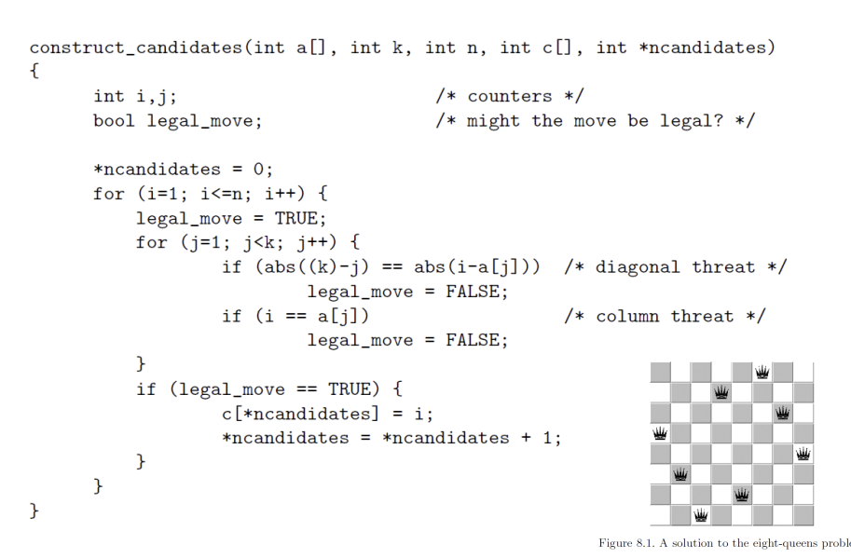
Solution explanation
When basing off the construct_candidates in the eight queens problem:
Disregard column threats to
adjust to bishops

Slide 6
Solution explanation
Otherwise, the rest follow the backtracking process:
Continually find all candidates for solutions and keep track of all the legal moves

Slide 7
Solution analysis
Pros: Safely checks all possible combinations
Cons: Since it is similar to brute force, the time complexity is worse
There may be a better and more methodological approach to this problem

Slide 8
Thank you!

